Slide 1

C++ PROGRAMMING
DAY 3
By SHIVAM GUPTA

Slide 2
CONTROL STATEMENTS
They helps us to change the order of execution.
If-else
Loops - for,while,do-while
Goto
switch

Slide 3
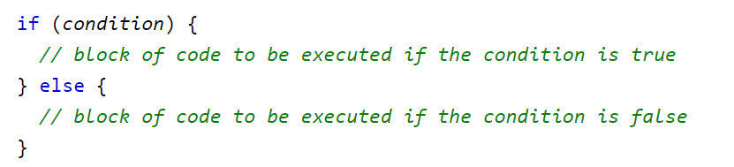
If else statements
If can also be executed without else part.
We can have nested if-else statements too.
If else ladder

Slide 4

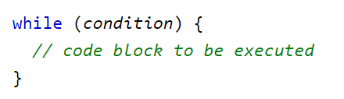
WHILE LOOP
Entry control loop

Slide 5
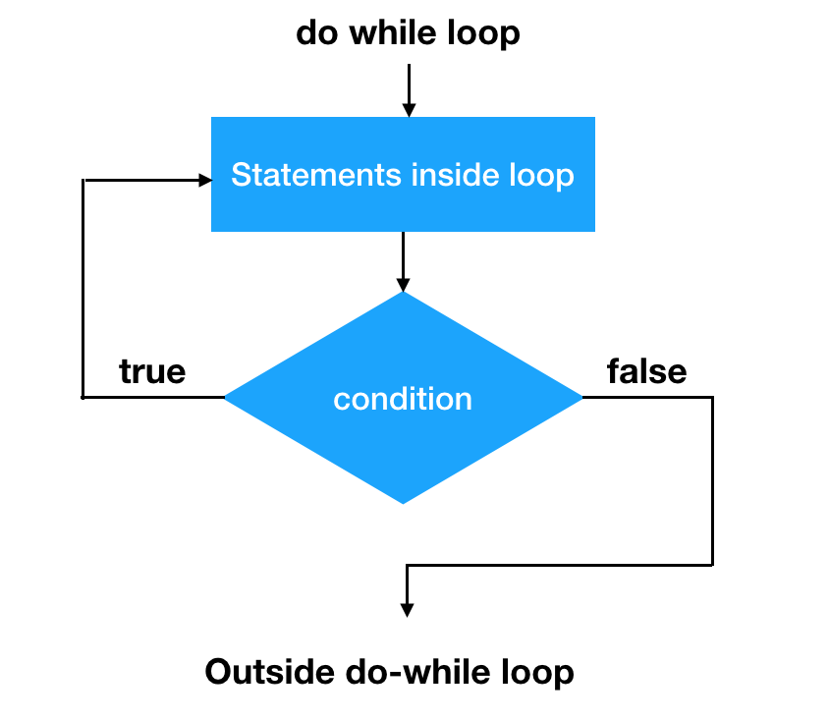
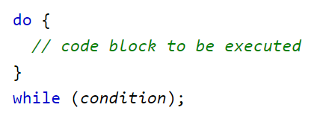
DO WHILE LOOP
Exit control loop
The body of the loop will be executed atleast once.

Slide 6
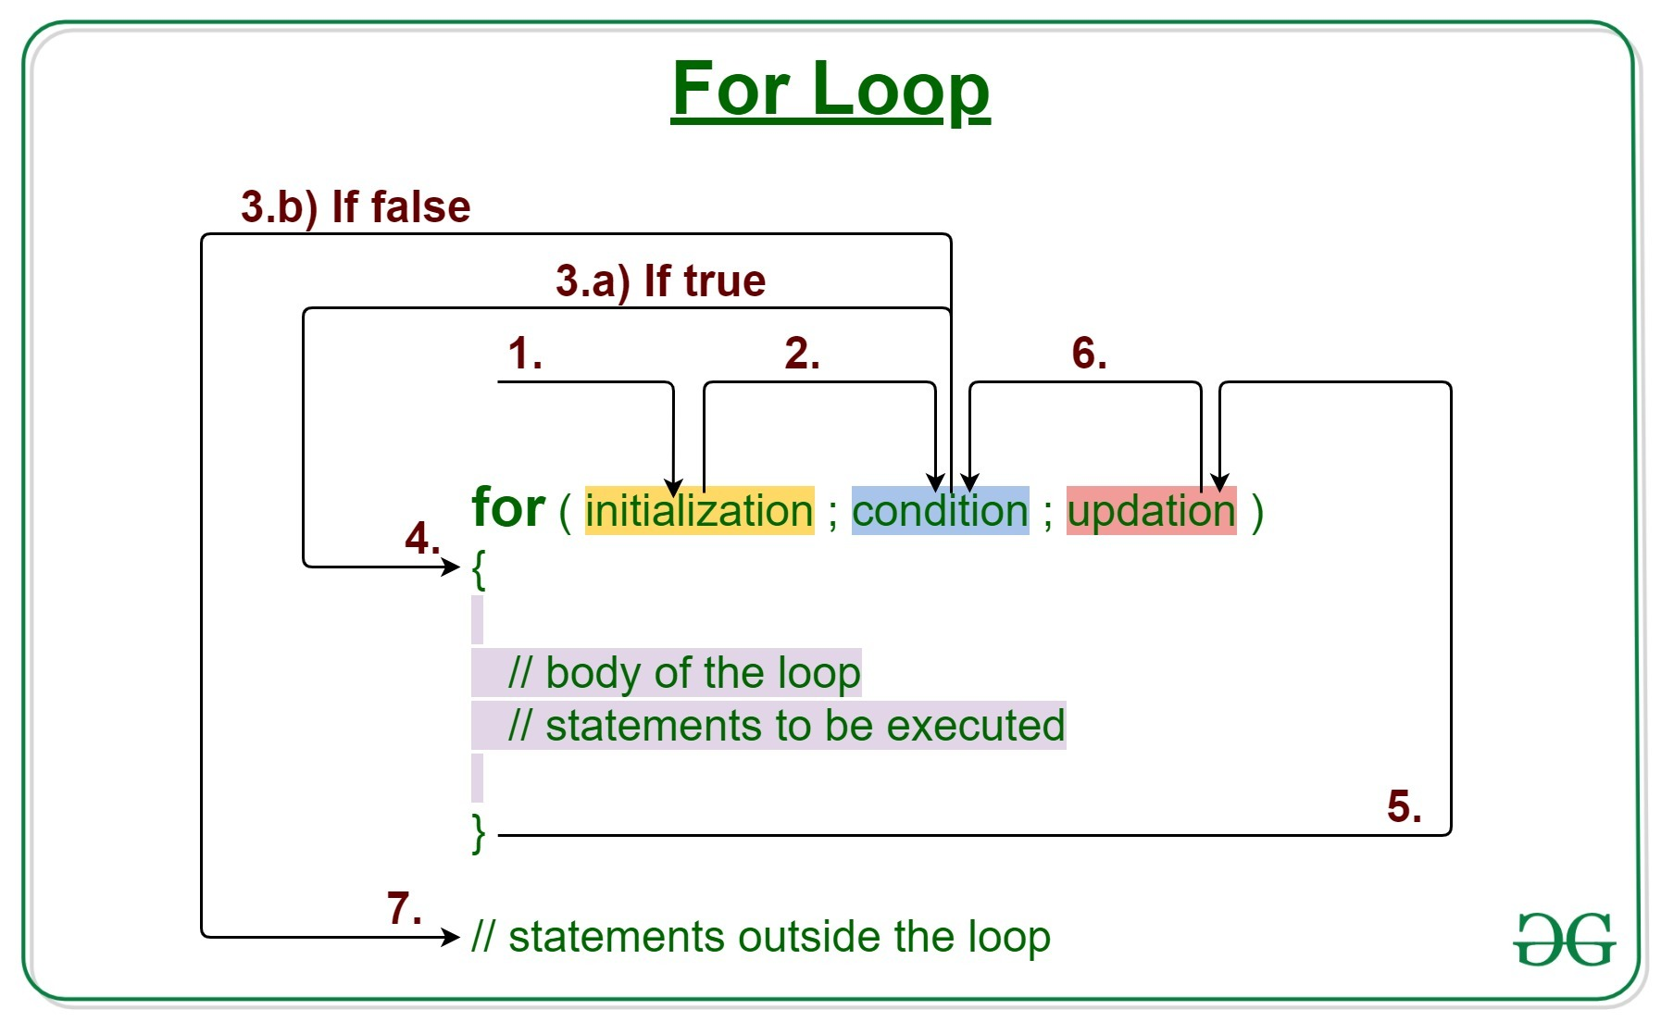
FOR LOOP

Slide 7
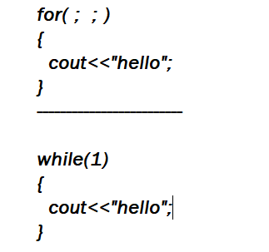
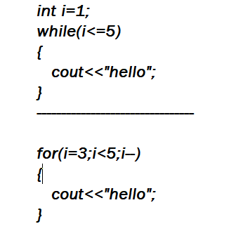
INFINITE LOOPS
We can also use multiple statements using commas
Lets see some common mistakes that leads to infinite loops.

Slide 8
BREAK AND CONTINUE
Break is used to stop the loop.
Continue is used to skip the statements present in the loop.

Slide 9
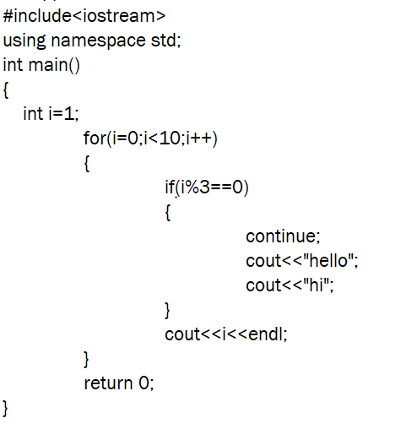
Predict the output.

Slide 10
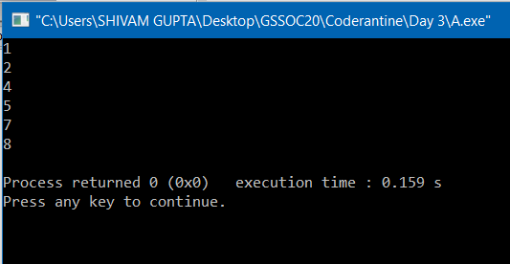

Slide 11
GOTO
Unconditional transfer of control
Uses labels , which are also identifiers
Forward jump , backward jump

Slide 12
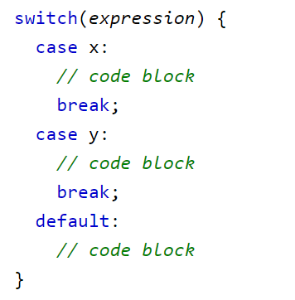
SWITCH CASE
Useful when we need to choose among various options.

